Slide 1
Surveys (Part I)
Week 5 Lecture
Becoming a Political Researcher (POL2017)

Slide 2


Politics Research Seminar Series
Hijacking Women's Health - How Women’s Health is Exploited in Global Politics
Professor Sophie Harman
Queen Mary, University of London
Wednesday 28th February 2024
1.15pm – 2.45pm
4.76 Henry Daysh Building
Abstract
Why do women still die when they don’t have to? The world has the tools, means, and a large amount of political will to stop this from happening. Yet for decades we see the repeat of similar patterns. Women doing more of the labour of healthcare. Women taking on greater economic, social, and political burdens as a consequence of major health emergencies. For every advancement in sexual and reproductive health, the threat of backlash. In this seminar, Sophie Harman will map key trends in how women’s health is used and abused for political advantage around the world; and offer a key provocation, that these trends are fundamental to understanding, and even predicting, the chaos and crisis the world finds itself in. Harman will offer a frank reflection of the state of women, gender, and global health in contemporary international relations, and offer a way of confronting these three forces to reclaim the fight for equality in health. Women and women’s health saw it coming.

Slide 3

Politics Roundtable:
‘Film and Method in Politics Research’
Thursday 28th February 2024
11.00am – 12.30pm
2.11 (Boardroom 2) Henry Daysh Building
Participants:
Professor Sophie Harman
Queen Mary, University of London
Dr Skyler Hawkins
Newcastle University
Dr Nila Premaratna
Newcastle University
Dr Nick Morgan
Newcastle University
Dr Philippa Page
Newcastle University

Slide 4
Recap
Last week - Literature reviews
What a literature review is, and why we do it
Resources for finding and evaluating literature
Managing the sources you find

Slide 5

Recap
Reference management software
Zotero, Endnote, Mendeley (and more)
- Organising the sources you find
- Reading and note taking
- Creating bibliographies

Slide 6
What we will cover
This week
What are surveys and what are they used for?
Variables and measurement
Designing surveys
Question design
Next week
Who do we ask? (sampling)
How we ask (survey mode)
Tips for running our own surveys
Using secondary survey data
Assessment 1 preparation

Slide 7


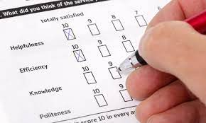
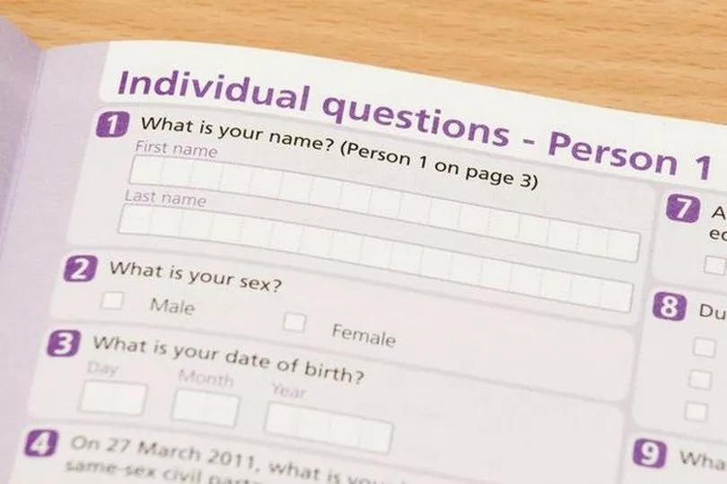
What is a survey?
Surveys are everywhere
Popular in social sciences, market research & psychology

Slide 8

What is a survey?
Gathering information by asking people questions
Questionnaire
The set of questions you ask respondents
Surveys
Process of planning, collecting and analysing data
- Self-completion questionnaires
- Face-to-face structured interviews

Slide 9
What is a survey?
Why use surveys?
Insight into what different sections of society think or do
Can make comparisons: over time, across countries
Find out about a population by asking just a sample

Slide 10
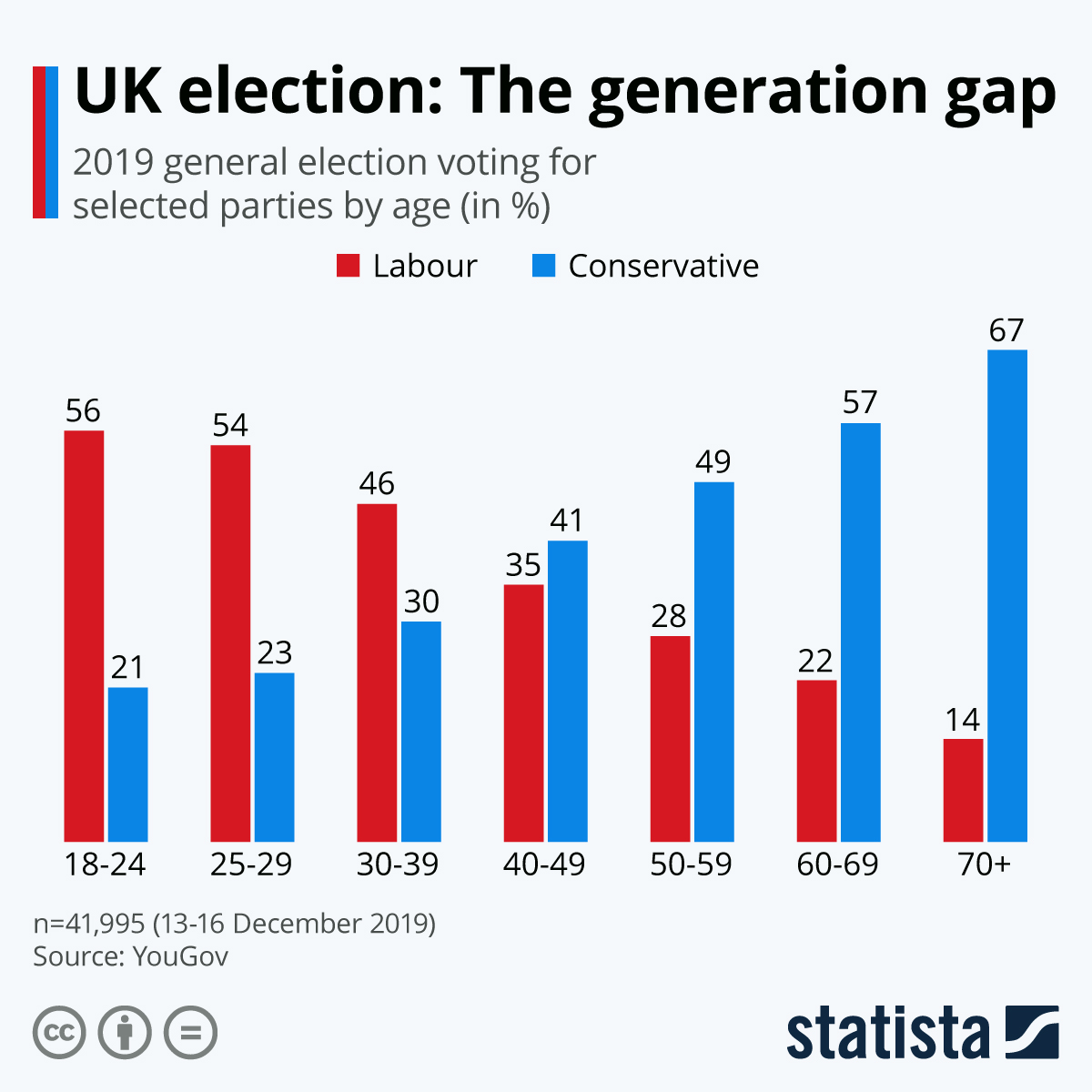
What are surveys used for?
Description
- Can describe patterns in
attitudes and behaviours
- Inductive

Slide 11
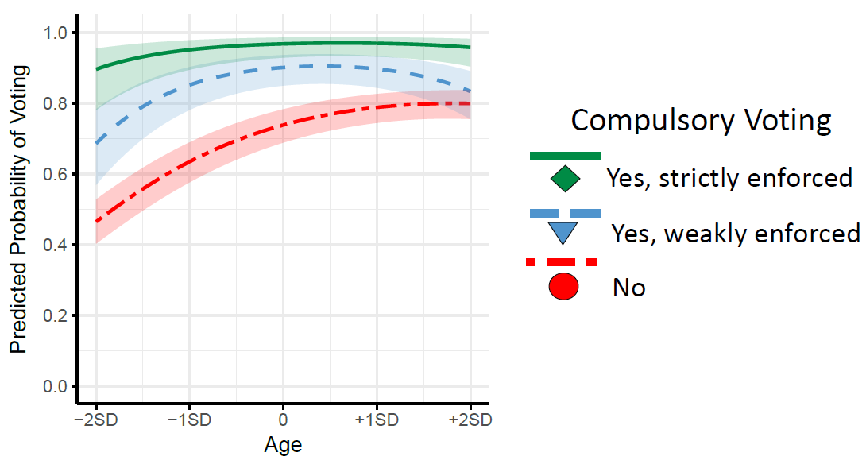
What are surveys used for?
Explanation
- Can test relationships
between variables
- Deductive

Slide 12
Strengths and Weaknesses
Strengths
Lots of data from lots of people
Relatively low cost
Generalisability
Reliability
Versatility
Weaknesses
Inflexible
Validity
Bias
Lack of depth

Slide 13
Variable Types

Slide 14
Survey questions
Concepts
Conceptualisation
Operationalisation
What questions can we ask to try and measure our key concepts?
From concepts to variables

Slide 15
Survey questions
Open questions
Respondents express themselves in their own words
Unstructured response data, qualitative
More detailed information, more difficult to analyse
In the space provided below, please tell us what you think is the most important issue facing society today:

Slide 16
Survey questions
Closed questions
Predefined response options
Structured response data
More limited information, easier to analyse
Which of the following options do you think is the most important issue facing society today:
□ the economy □ the environment □ immigration
□ housing □ healthcare □ education

Slide 17
Variable types
For closed questions, we need to think about the type of response options we should include
This will depend on our variable’s level of measurement
The four main variable types are:
1) Nominal
2) Ordinal
3) Interval
4) Ratio

Slide 18

Variable types
Nominal
Two or more categories
No inherent order to categories
Examples
Colours: Red, green, blue, purple
Subject areas: Politics, Geography, Chemistry

Slide 19

Variable types
Ordinal
Ordered categories
Distance between categories not consistent
Examples
Education: primary, secondary, tertiary
Class: working, middle, upper

Slide 20
Variable types
Ordinal
Ordered categories
Distance between categories not consistent
Likert scale
Strongly agree
Agree
Neither agree nor disagree
Disagree
Strongly disagree

Slide 21

Variable types
Interval
Ordered categories
Set distance between each value
No true zero point
Examples
Temperature: Celsius, Farenheit
Years (AD/BC): 2014, 1970, 500BC

Slide 22

Variable types
Ratio
Ordered categories
Set distance between each value
Meaningful zero point
0 = total absence of variable being measured
Examples
Weight: 0kg = no weight present
Population
Income

Slide 23
Variable types
Type | Definition | Examples
Nominal | Two or more categories No order to categories | Colours Names
Ordinal | Ordered categories Distance between categories not consistent | Education level Social class
Interval | Ordered categories Set distance between each value | Temperature Time (years)
Ratio | Ordered categories Set distance between each value Meaningful zero point | Income Population

Slide 24
Discussion Question
What type of measurement could we use for the following variables?
Age
Party affiliation
Variable types: Nominal, Ordinal, Interval, Ratio

Slide 25
Discussion Question
Age
Ordinal (age groups)
Ratio (age in years)
□ 18-36
□ 37-59
□ 60+
42 years old

Slide 26
Discussion Question
Party affiliation
Nominal
(no inherent order among parties)
□ Labour
□ Conservative
Green
□ LibDem
□ SNP
□ Plaid Cymru

Slide 27
Discussion Question
What type of measurement could we use for the following variable?
3. Immigration attitudes
Variable types: Nominal, Ordinal, Interval, Ratio

Slide 28
Discussion Question
Immigration attitudes
Nominal
(question with a yes/no response)
Ordinal
(5 point Likert scale)
Interval
(0-100 agreement scale)
Do you agree with the following statement: “…”
□ Yes
No
Don’t know

Slide 29
Discussion Question
Immigration attitudes
Nominal
(question with a yes/no response)
Ordinal
(5 point Likert scale)
Interval
(0-100 agreement scale)
To what extent do you agree with the following statement: “…”
□ Strongly agree
□ Agree
Neither agree nor disagree
□ Disagree
□ Strongly disagree

Slide 30
Discussion Question
Immigration attitudes
Nominal
(question with a yes/no response)
Ordinal
(5 point Likert scale)
Interval
(0-100 agreement scale)
To what extent do you agree with the following statement: “…”
Please add a value between 0-100,
where 0 = complete disagreement,
and 100 = full agreement.
0……………………………………..100

Slide 31
Variable types
Type | Definition | Examples
Nominal | Two or more categories No order to categories | Colours Names
Ordinal | Ordered categories Distance between categories not consistent | Education level Social class
Interval | Ordered categories Set distance between each value | Temperature Time
Ratio | Ordered categories Set distance between each value Meaningful zero point | Income Population

Slide 32
Survey Design

Slide 33
Designing surveys
What questions to ask
Who to ask (sampling, next week)
How to ask it (survey mode, next week)

Slide 34
Designing surveys
What to ask?
What information do you need to answer your research question?
Include questions that can capture our key concepts
Dependent and independent variables
Control variables
May want multiple indicators for each concept

Slide 35
Designing surveys
Question order
Responses to a question may be influenced by
what has been asked previously
Context in which question is asked
Position relative to other questions
Priming effects, consistency with previous answers
Ask key questions near the start

Slide 36


Designing surveys
Bailey (2021)
Public attitudes about country’s economic performance
Asked groups with different party support, political or non-political survey questions
Priming of party affiliation

Slide 37
Designing surveys
Political Survey
Q1. If there were a general election held tomorrow, which party would you vote for?
Conservative
Labour
Liberal Democrat
Scottish National Party (SNP)
Plaid Cymru
Brexit Party
Green
Some other party
Would not vote
Don’t know
Non-political Survey
Q1. Imagine that you need to buy toothpaste in the near future, which brand would you choose?
Colgate
Sensodyne
Aquafresh
Oral-B
Macleans
Arm & Hammer
Crest
Some other brand
I would not buy toothpaste
Don’t know

Slide 38
Designing surveys
Bailey (2021)
Bias in our measurement due to survey context
Government supporters were more likely to give positive economic view in political versus non-political surveys

Slide 39
Designing surveys
Survey length
Too many questions may impact response rates
Only include relevant questions (filters, follow-ups)
Open questions require more input
Survey fatigue

Slide 40
Question Design

Slide 41
Asking questions
Specific wording of the questions we will ask
Deciding on appropriate response options
Requires background knowledge
We want our questions to:
Minimise measurement error
Maximise validity
Maximise reliability

Slide 42
What we ask: Question Design
Wording & comprehension
Recall
Misreporting
Subjective & objective measures
Double-barrelled questions
Leading questions
Response options
Attention

Slide 43
What we ask: Question Design
Wording & comprehension
Be clear and concise
Avoid jargon, be specific
Clear instructions for how to respond
‘How often do you take part in political activities?’
‘Do you think the executive should promote legislation to curtail socioeconomic inequality?

Slide 44
What we ask: Question Design
Recall
People’s memory can be unreliable
Difficult to remember distant or less important events
‘Which party did you vote for in the 1997 local elections?’
‘How many times have you signed a petition in the last 15 years?’

Slide 45
What we ask: Question Design
Misreporting
Can be intentional or unintentional
Social desirability bias
Acquiescence bias
Affected by survey mode

Slide 46

Example: Voter Turnout
USA 2004 Election
Official turnout =
Survey self-reported turnout =
56%
76%
Albania 2005 Election
Official turnout =
Survey self-reported turnout =
49%
91%
Source: Selb & Munzert (2013: 186); Comparative Study of Electoral Systems Survey

Slide 47
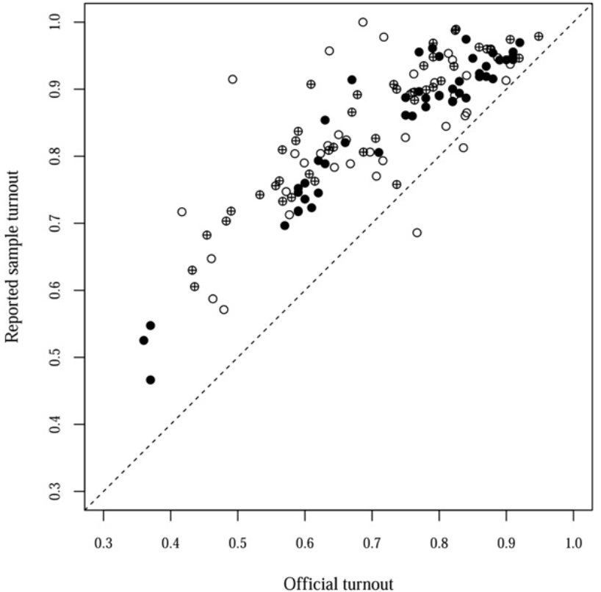
Average overreporting:
13%
Source: Selb & Munzert (2013: 187)

Slide 48
Discussion question
Why do you think surveys often report higher voter turnout rates compared to official figures?

Slide 49
What we ask: Question Design
Double-barrelled questions
Asking about multiple issues within a single question
Which part are respondents answering about?
Separate these questions: ask one thing a time
‘Do you love studying Politics and History?’
‘Would you support a leader in favour of raising healthcare and military spending?’

Slide 50
What we ask: Question Design
Leading questions
Wording/framing can influence the responses we get
Tries to push people to answer a certain way
Question wording should be as neutral as possible
‘How much do you hate Donald Trump?’
‘Do you agree that Scotland should be an independent country?’

Slide 51
What we ask: Question Design
Response options
Should cover the full range of values
Should be mutually exclusive (if we can select just one)
Midpoints, forced choice
Don’t know/unsure, prefer not to answer
‘Other’ category (open-ended follow up questions)

Slide 52
What we ask: Question Design
Attention
Survey fatigue, or don’t know how to answer
Common to select same option for lots of questions
Can include attention checks
Ask about previous questions
Change response order for similar question

Slide 53
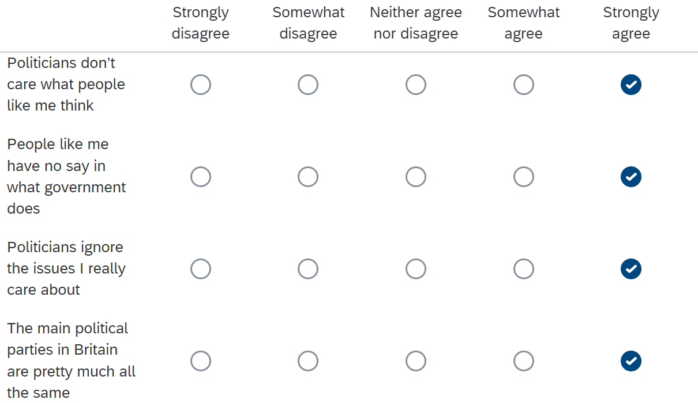

Slide 54
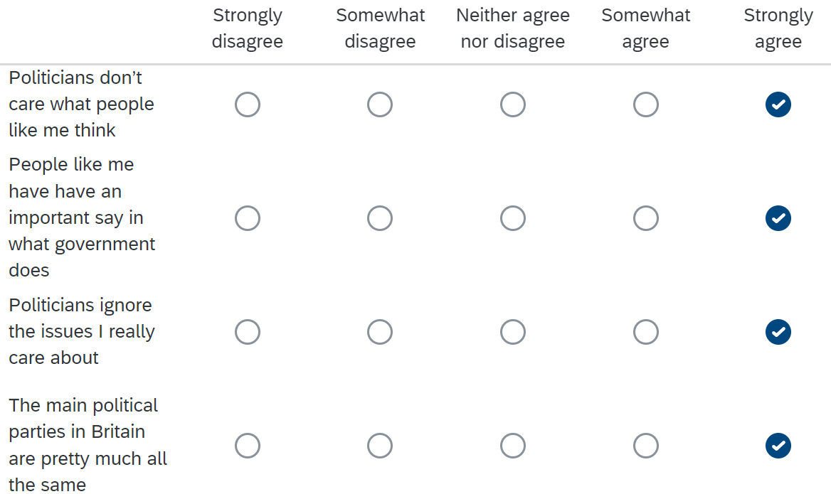

Slide 55
What we ask: Question Design
Subjective & objective measures
Different ways we ask about the same concept
Same term can mean different things to different people

Slide 56
Discussion question
Suppose we are researching the relationship between socioeconomic class and foreign policy attitudes.
How could we try and measure socioeconomic class using a survey?
How can we define class? What features can we measure?
What question/s should we ask?
Question type, wording, response options

Slide 57
Discussion question
Subjective self-reported class
‘Do you feel as though you belong to a specific social class?’
‘Would you describe yourself as: Working, middle, or upper class?’
Context specific? Consistent over time?
Objective indicators
Income, occupation, employment status, education, leisure/consumer behaviour, parental class, home ownership

Slide 58
Summary

Slide 59
Surveys
Gather information by asking people questions
Find out what sections of society think or do
Can be used for description & explanation

Slide 60
Surveys
Strengths
Lots of data from lots of people
Relatively low cost
Generalisability
Reliability
Versatility
Weaknesses
Inflexible
Validity
Bias
Lack of depth

Slide 61
Surveys
Question types
Open questions
Closed questions
Variable types:
Nominal
Ordinal
Interval
Ratio

Slide 62
Surveys
Survey design
Which questions to ask
How many questions to include
Question ordering effects
Question design
Wording & comprehension
Recall
Misreporting
Subjective & objective measures
Double-barrelled questions
Leading questions
Response options
Attention

Slide 63
POL2017 Assessment 1

Slide 64
Assessment 1
Take home essay
1,000 words (±10%)
Bibliography not included in word count
Due: Monday 11th March, 12pm noon
Submit on canvas, anonymous submission
Assessment guide now on canvas

Slide 65
Assessment 1
Write a response to BOTH of the following prompts:
1) In roughly 500 words, drawing on the relevant literature, provide definitions of the following four concepts – Ontology, Epistemology, Methodology and Method – and highlight the relationships between them.
2) Select quantitative OR qualitative methods. In the next approximately 500 words, explain what types of research questions are best suited to your chosen approach.

Slide 66
Assessment 1
1) In roughly 500 words, drawing on the relevant literature, provide definitions of the following four concepts – Ontology, Epistemology, Methodology and Method – and highlight the relationships between them.
Topics from Weeks 1 & 3 (method/ology, quant/qual)
How can we define these four terms?
To what extent are these concepts interconnected?

Slide 67
Assessment 1
2) Select quantitative OR qualitative methods. In the next approximately 500 words, explain what types of research questions are best suited to your chosen approach.
Topics from Weeks 2 & 3 (Research questions, quant/qual)
First:
Pick either quantitative or qualitative methods
Then we need to think about:
What is our chosen method? Brief definition.
What different types of research questions can we ask?
What are the strengths and limitations of your chosen method?

Slide 68
Assessment 1
Tips
Use notes from seminar questions and assigned readings
- Can bring in additional sources, supplementary readings, finding sources ourselves
Limited word count
- Brief introduction and concluding sentences
- Then get straight to the point
- Avoid lengthy quotes
- Paraphrase and summarise, but reference appropriately

Slide 69
Assessment 1
Referencing guide on canvas page
Cite them right
Can use Harvard or Chicago, but be consistent!
In text citations
Summarising general point = (author, year)
Direct quotes = always include page number (author, year page)
Paraphrasing specific point = include page number (author, year page)
Bibliography
Only include sources you cited within the essay

Slide 70
Assessment 1
More information available on canvas
Any questions, please come along to office hours

Slide 71
References
Bailey, J. (2022) ‘Political Surveys Bias Self-Reported Economic Perceptions’, Public Opinion Quarterly, 85(4), pp. 987–1008. Available at: https://doi.org/10.1093/poq/nfab054.
Selb, P. and Munzert, S. (2013) ‘Voter overrepresentation, vote misreporting, and turnout bias in postelection surveys’, Electoral Studies, 32(1), pp. 186–196. Available at: https://doi.org/10.1016/j.electstud.2012.11.004.

